Slide 1
The French Revolution
1789

Slide 2
Causes of French Revolution
Ideas of liberty and equality from the American Revolution (note: Constitution was signed 2 yrs before in 1787)
Enlightenment ideas of John Locke

Slide 3
Causes of French Revolution
Vast majority of people were broke and hungry.
Vast majority were in the lowest estate

Slide 4
Three Estates

Slide 5
bourgeoisie
Part of the third estate, they were the “middle class” of France.
They were bankers, merchants, factory owners (educated people)
Led the revolution

Slide 6
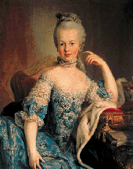
Revolution - beginnings
Although people were starving and the country was broke, the royal family flaunted their wealth and uncaring.

Slide 7
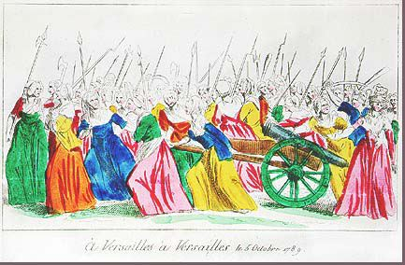
Bread riots
People were hungry; the country was broke.
This picture is from an all-woman bread riot.
Marie Antionette said “let them eat cake”

Slide 8
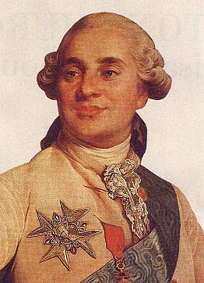
King Louis XVI
His grandfather Louis XIV was the ultimate “absolutist” king.
This king was weak
He had so little control, he called for the French congress to fix some problems

Slide 9
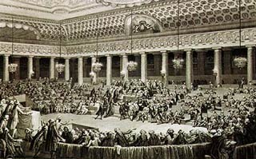
Estates General meets
The part of the French Congress representing the third estate left and declared themselves THE congress of France.

Slide 10
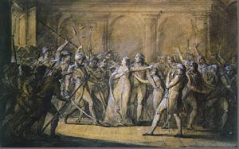
Events continued
French created their own Declaration of the Rights of Man and Citizen modeled after TJ’s Declaration of Independence

Slide 11
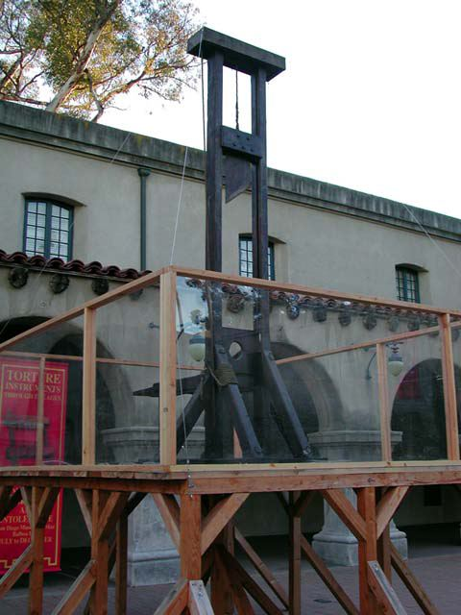
Effects of the French Revolution
Both the King and Queen were beheaded
French monarchy no more
In addition to the Royal family, 17,000 people were executed with the guillotine.

Slide 12
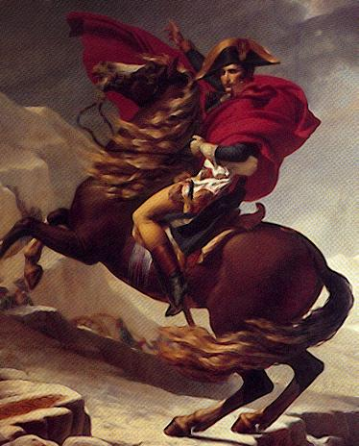
Effects continued. . .
Napoleon Bonaparte was elected leader, then appoints himself emperor of France.
Sold Louisiana to TJ

Slide 14
This powerpoint was kindly donated to www.worldofteaching.com
http://www.worldofteaching.com is home to over a thousand powerpoints submitted by teachers. This is a completely free site and requires no registration. Please visit and I hope it will help in your teaching.

